Slide 1

Booker Avenue
30th April - 2nd May 2025

Slide 2

PGL
Boreatton Park, Shropshire.
The main aims for PGL are:
- to have fun
- be with friends
- develop independence
- gain in confidence
- try new activities
- gain the experience of a residential trip

Slide 3
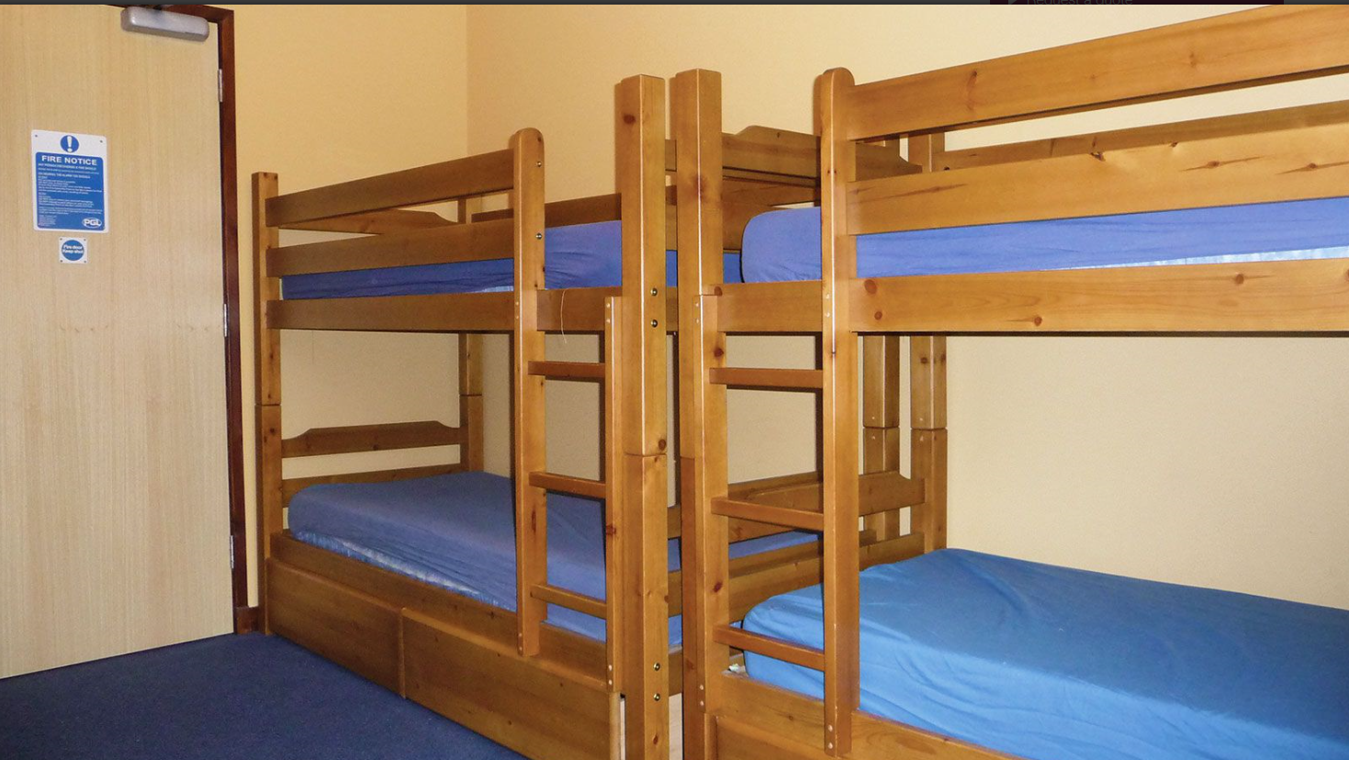
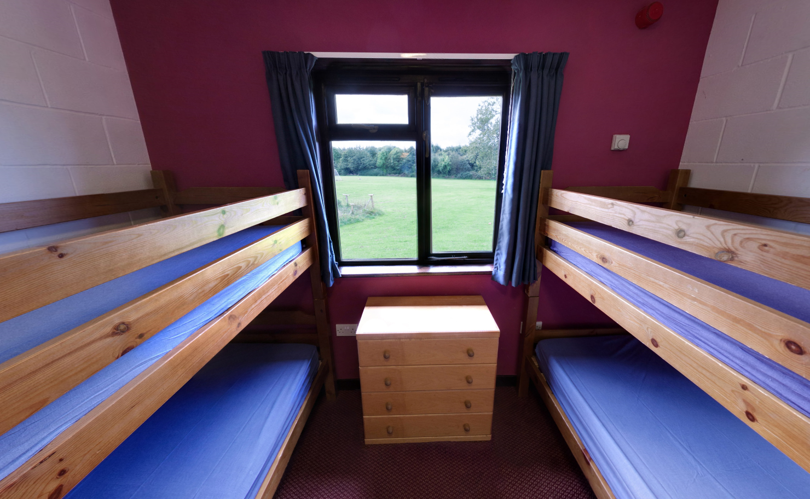
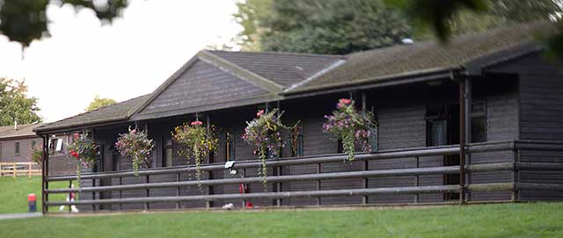
Rooms and Accommodation

Slide 4
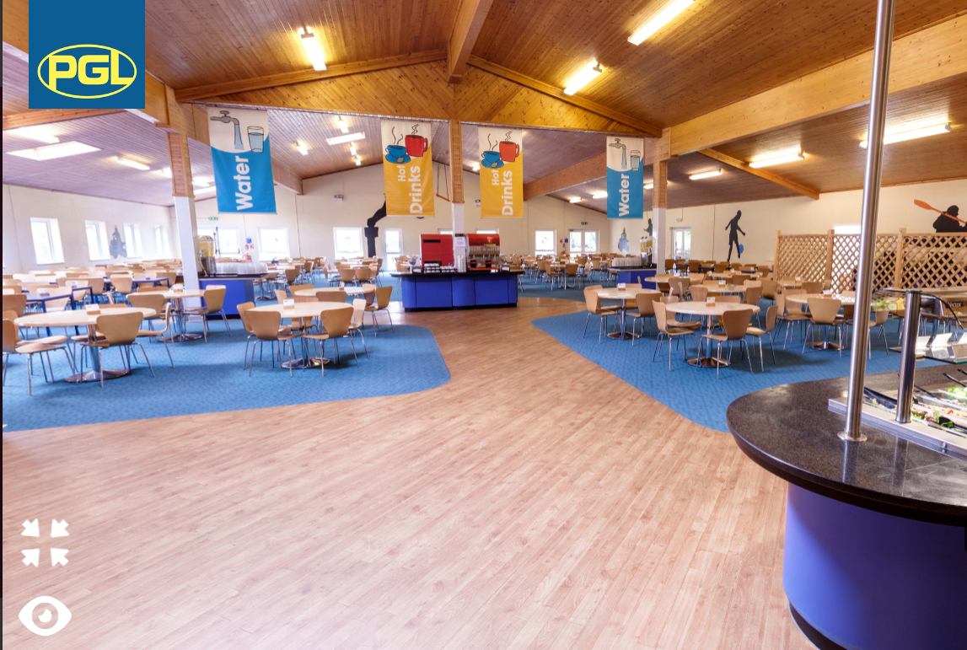
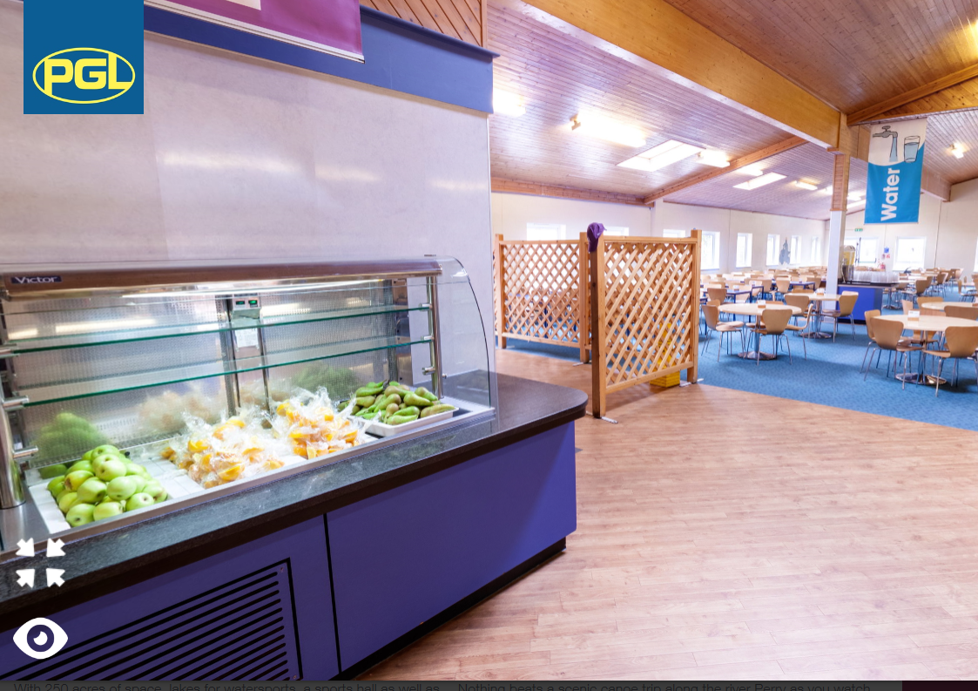
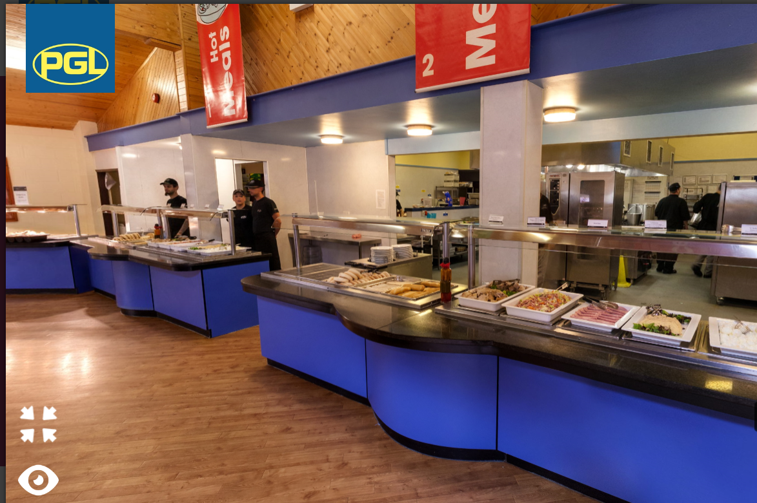
Catering
The canteen caters for both hot
and cold meals. They also cater
for any special dietary
requirements.

Slide 5
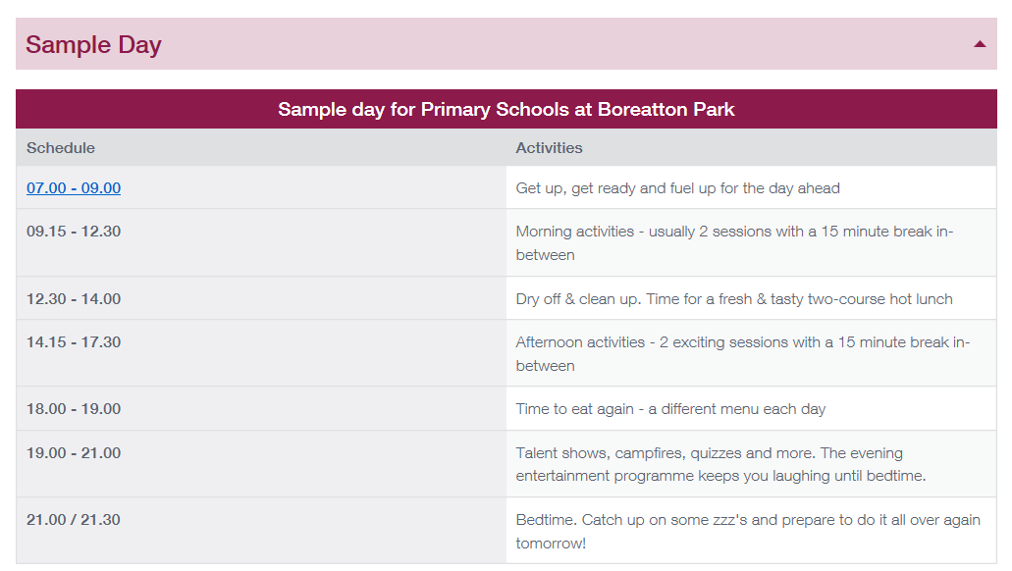
There is also a tuck shop which the children can buy souvenirs and sweets.

Slide 6
Y4 Activities
We will know our itinerary about a week before we go but we usually have
a mixture of the following activities:
Kayaking
Zip wire
Abseil
Sensory trail
Climbing
Puzzle Park
Giant Swing
Campfire (evening)
Silent Disco (evening)

Slide 7
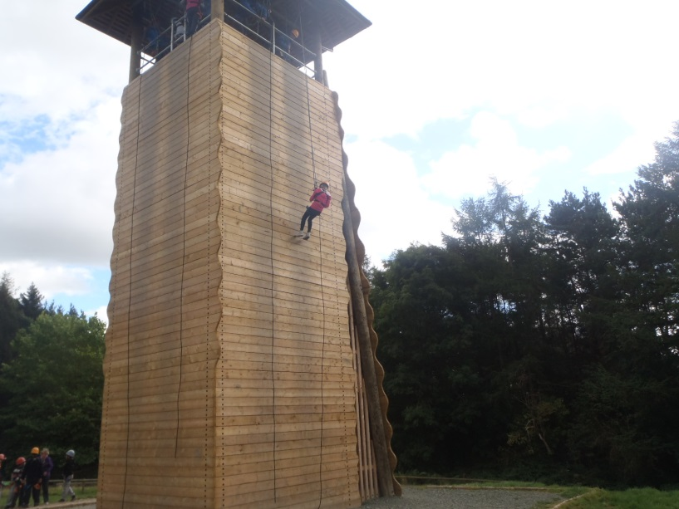
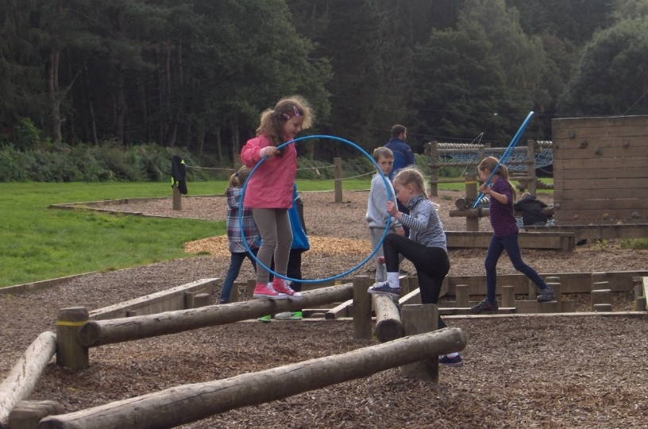
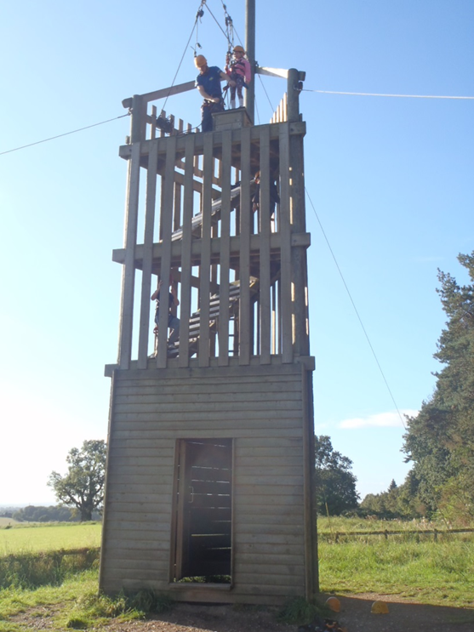
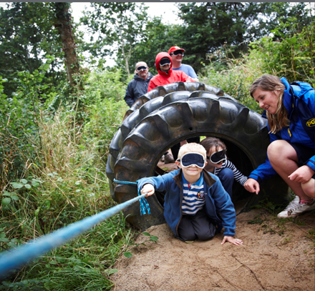

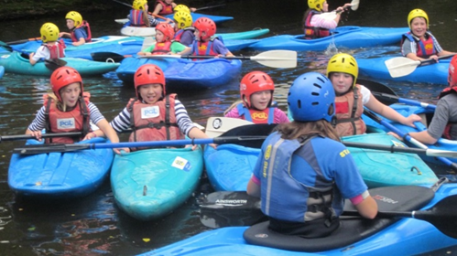
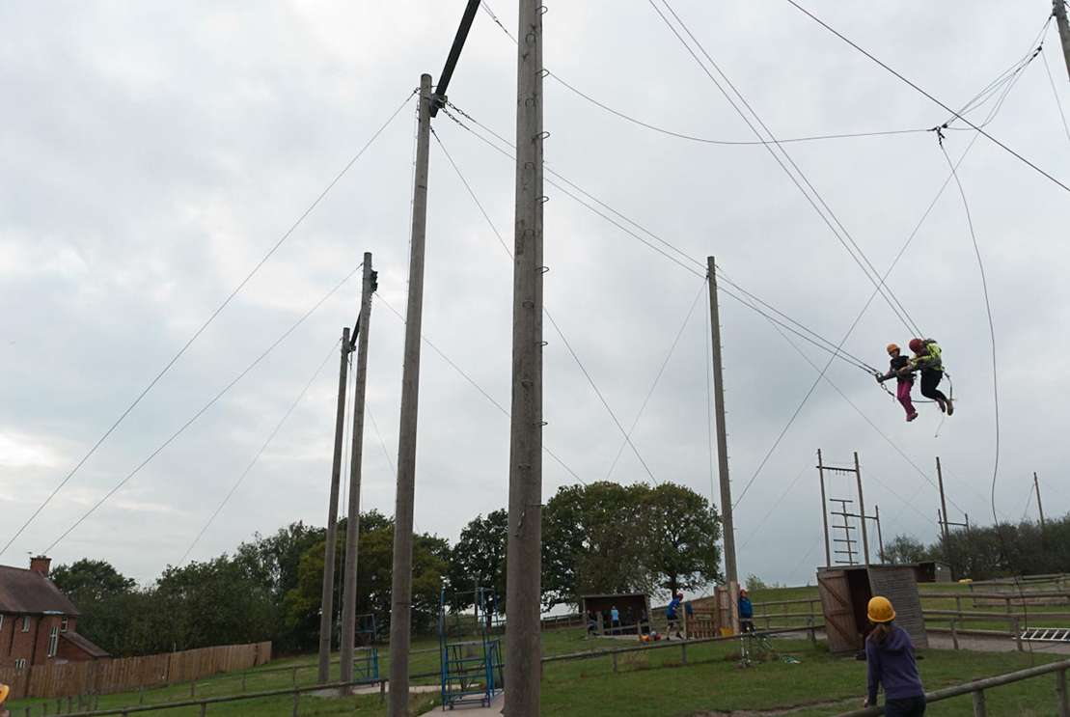
Puzzle Park
Abseiling
Zip Wire
Giant Swing
Kayaking

Slide 8
Clothes:
Suitable night wear
Underwear and socks (plenty!)
Trousers/tracksuit bottoms/ leggings
Fleece/sweatshirts (it does get very cold at night time when we are out on activity)
Long sleeved shirt/ t-shirt
T-shirts
Waterproof jacket
Warm jacket
Hat – woolly or cap (dependent on weather while we’re there)
2 pairs of trainers for activities
1 pair of trainers for water sports – these will get very wet and smelly
What to take?
Towels x2
Water bottle
Small bag/rucksack
Labelled bin bags for wet and dirty clothing
Wash bag
Sun cream
Lip balm and hand moisturiser (it can be cold and quite windy, last year a lot of children had dry hands and lips)
Books/Comics
Disposable camera or a very old digital camera can you won’t mind if it gets lost.
Do not bring:
•Mobile phone
•Electronics
•Wellies
•Torch
•Any valuable or very sentimental – things do get lost or misplaced.
PGL is on a very large site and it is impossible to search it all if something is lost.

Slide 9
Clothing & Lost property
Please label everything.
Don’t bring expensive or new clothes.
Clothes will get wet and dirty during activities.
Jeans are not suitable for activities as they get heavy and cold when wet.
If anything is left at PGL it is difficult to trace and there is a charge for returning items.

